Slide 1


Changing Sun
The Sun changes through the day.

Slide 2
Changing Sun
a. How does the Sun appear to change through a day?
A The Sun goes up in the morning and down at night
B The Sun moves in an arc
(it follows the shape of a rainbow)
C The Sun gets brighter each morning and fades again at night
D The Sun goes up in the morning and carries on over our heads

Slide 3
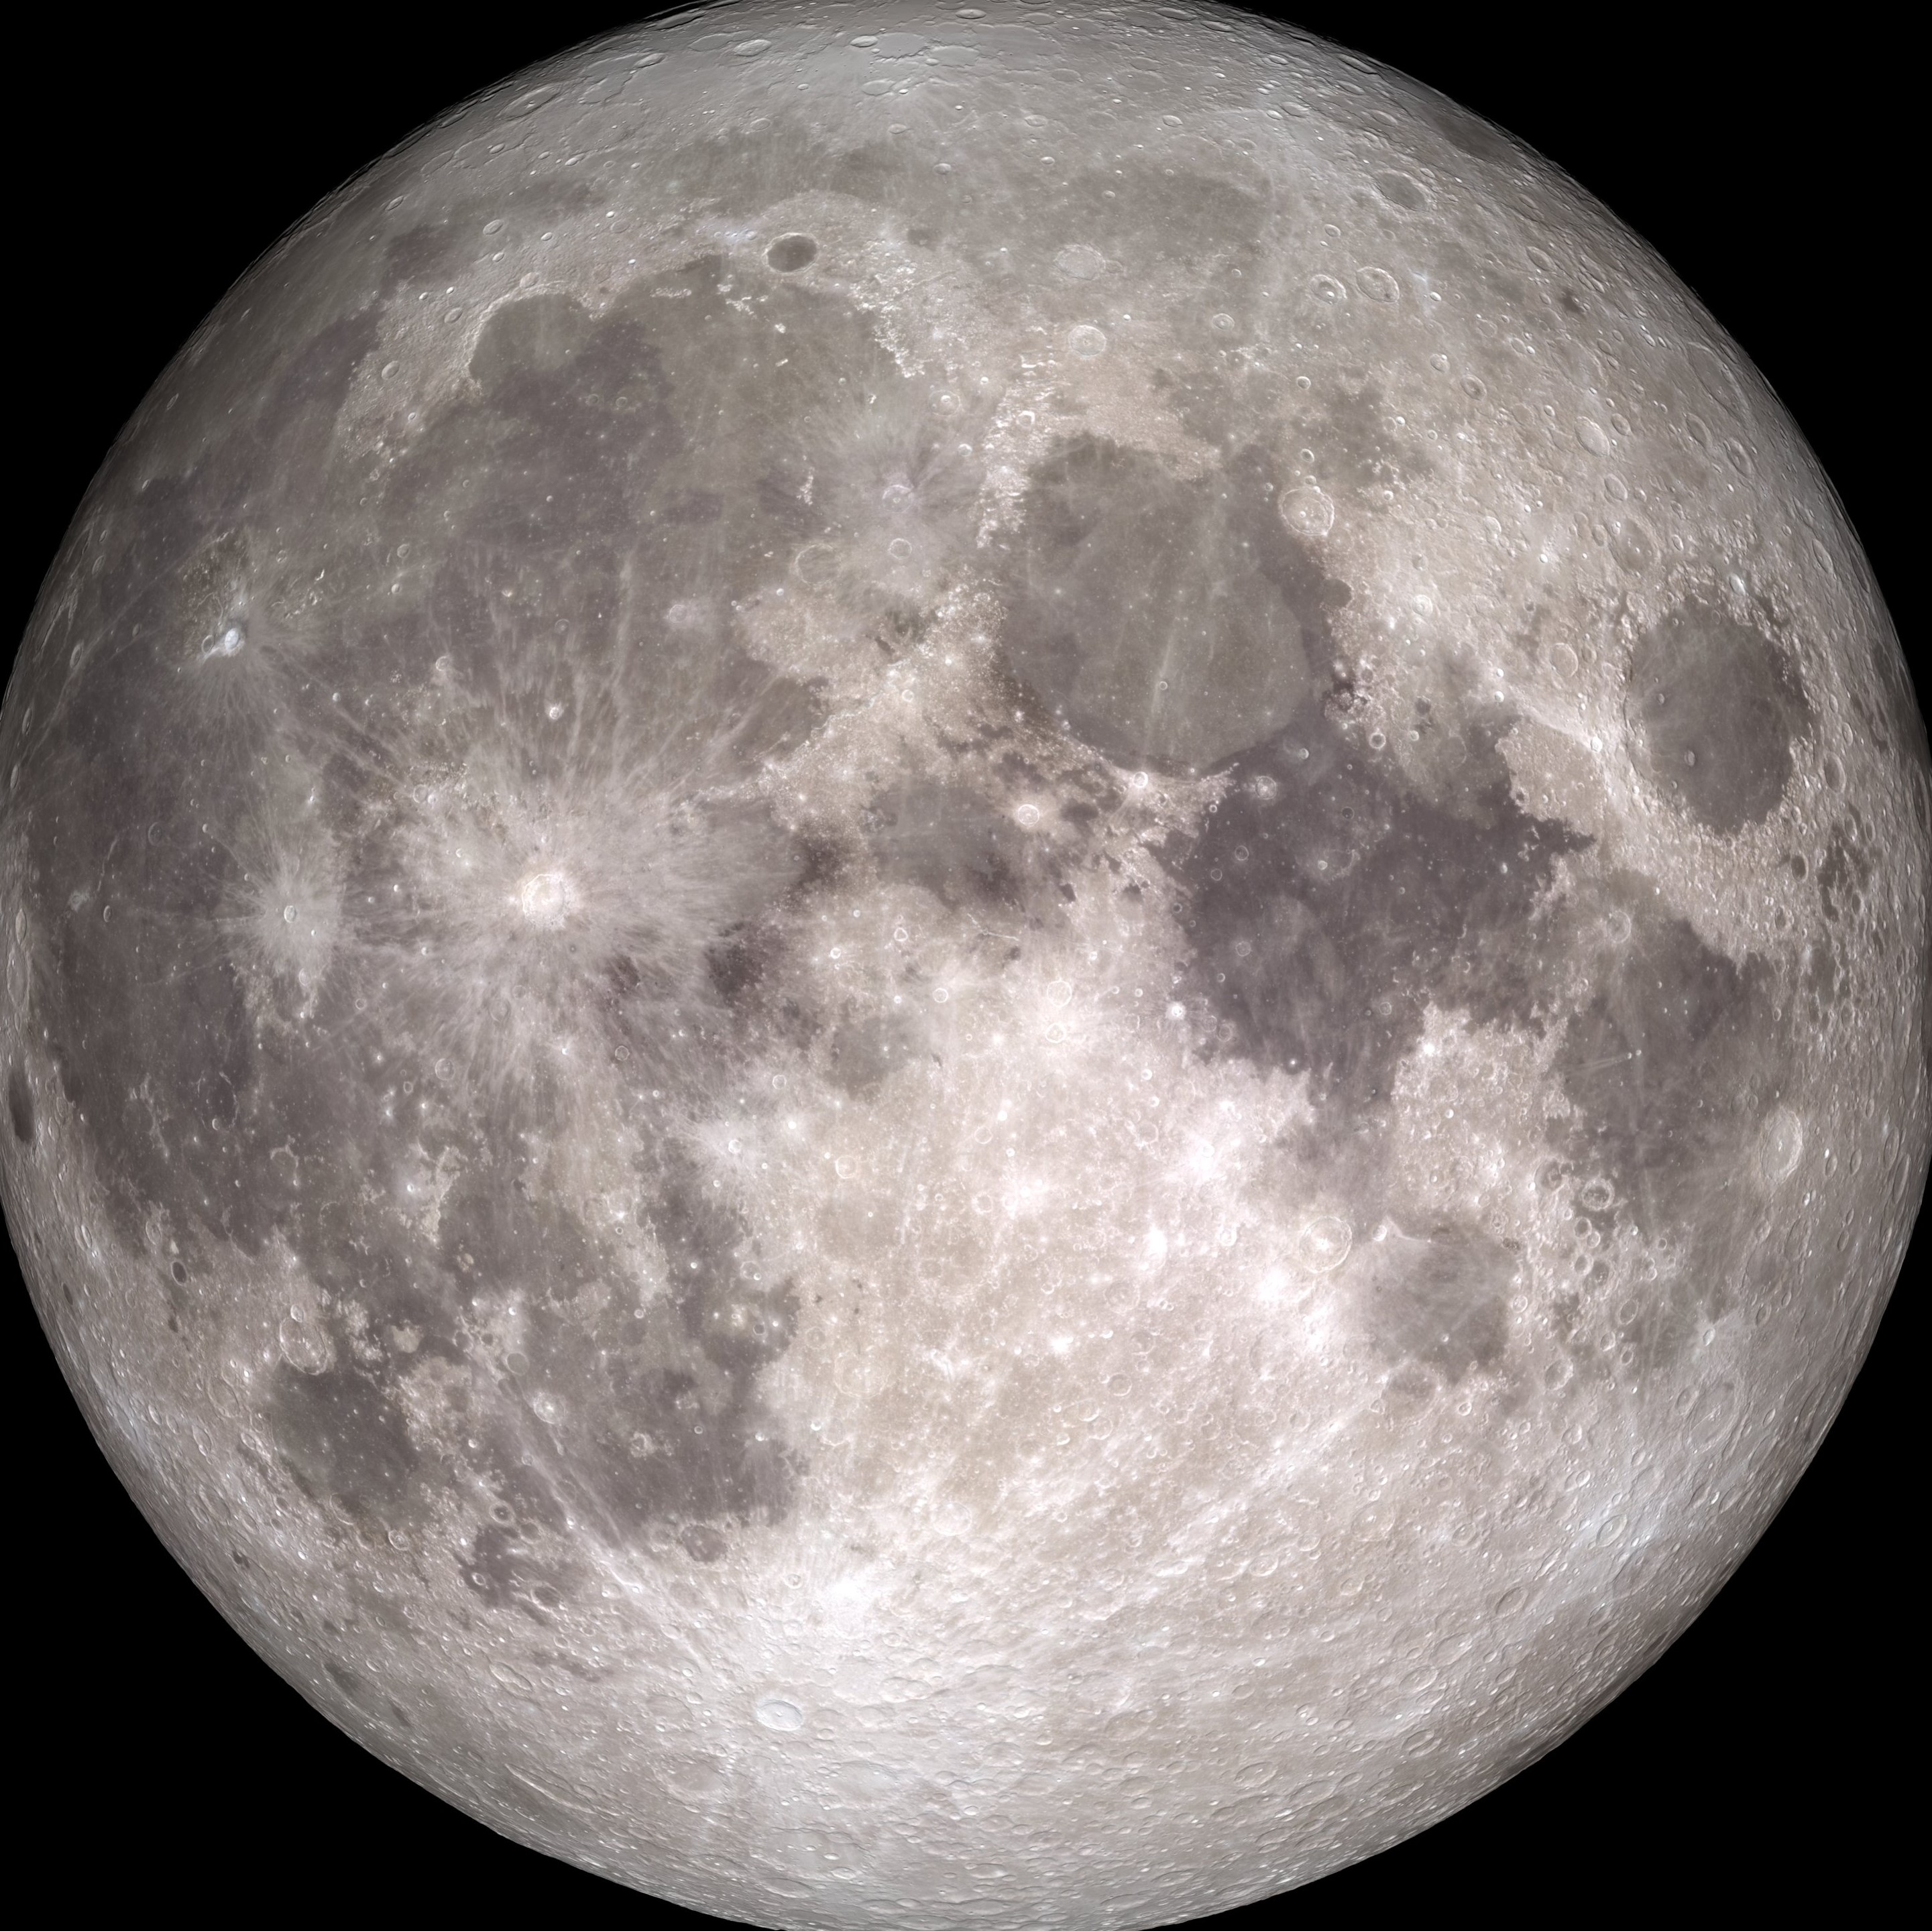
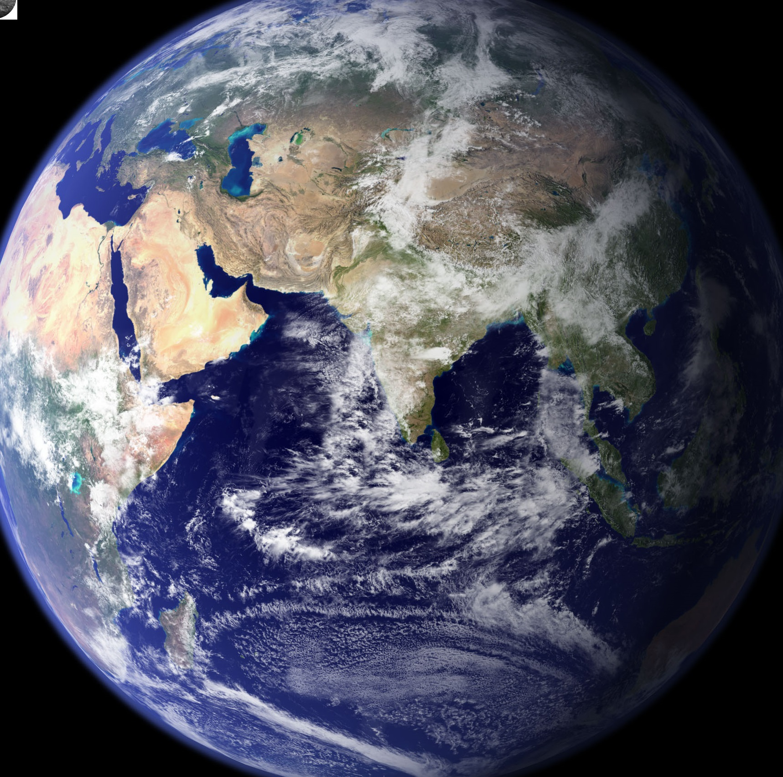
Changing Sun
b. What is the best reason for your last answer?
A Sun’s light is blocked when it’s behind the Moon
B Sun orbits the Earth
once a day
C Earth spins on its axis
once a day
D Earth orbits the Sun
once a day

